Slide 1

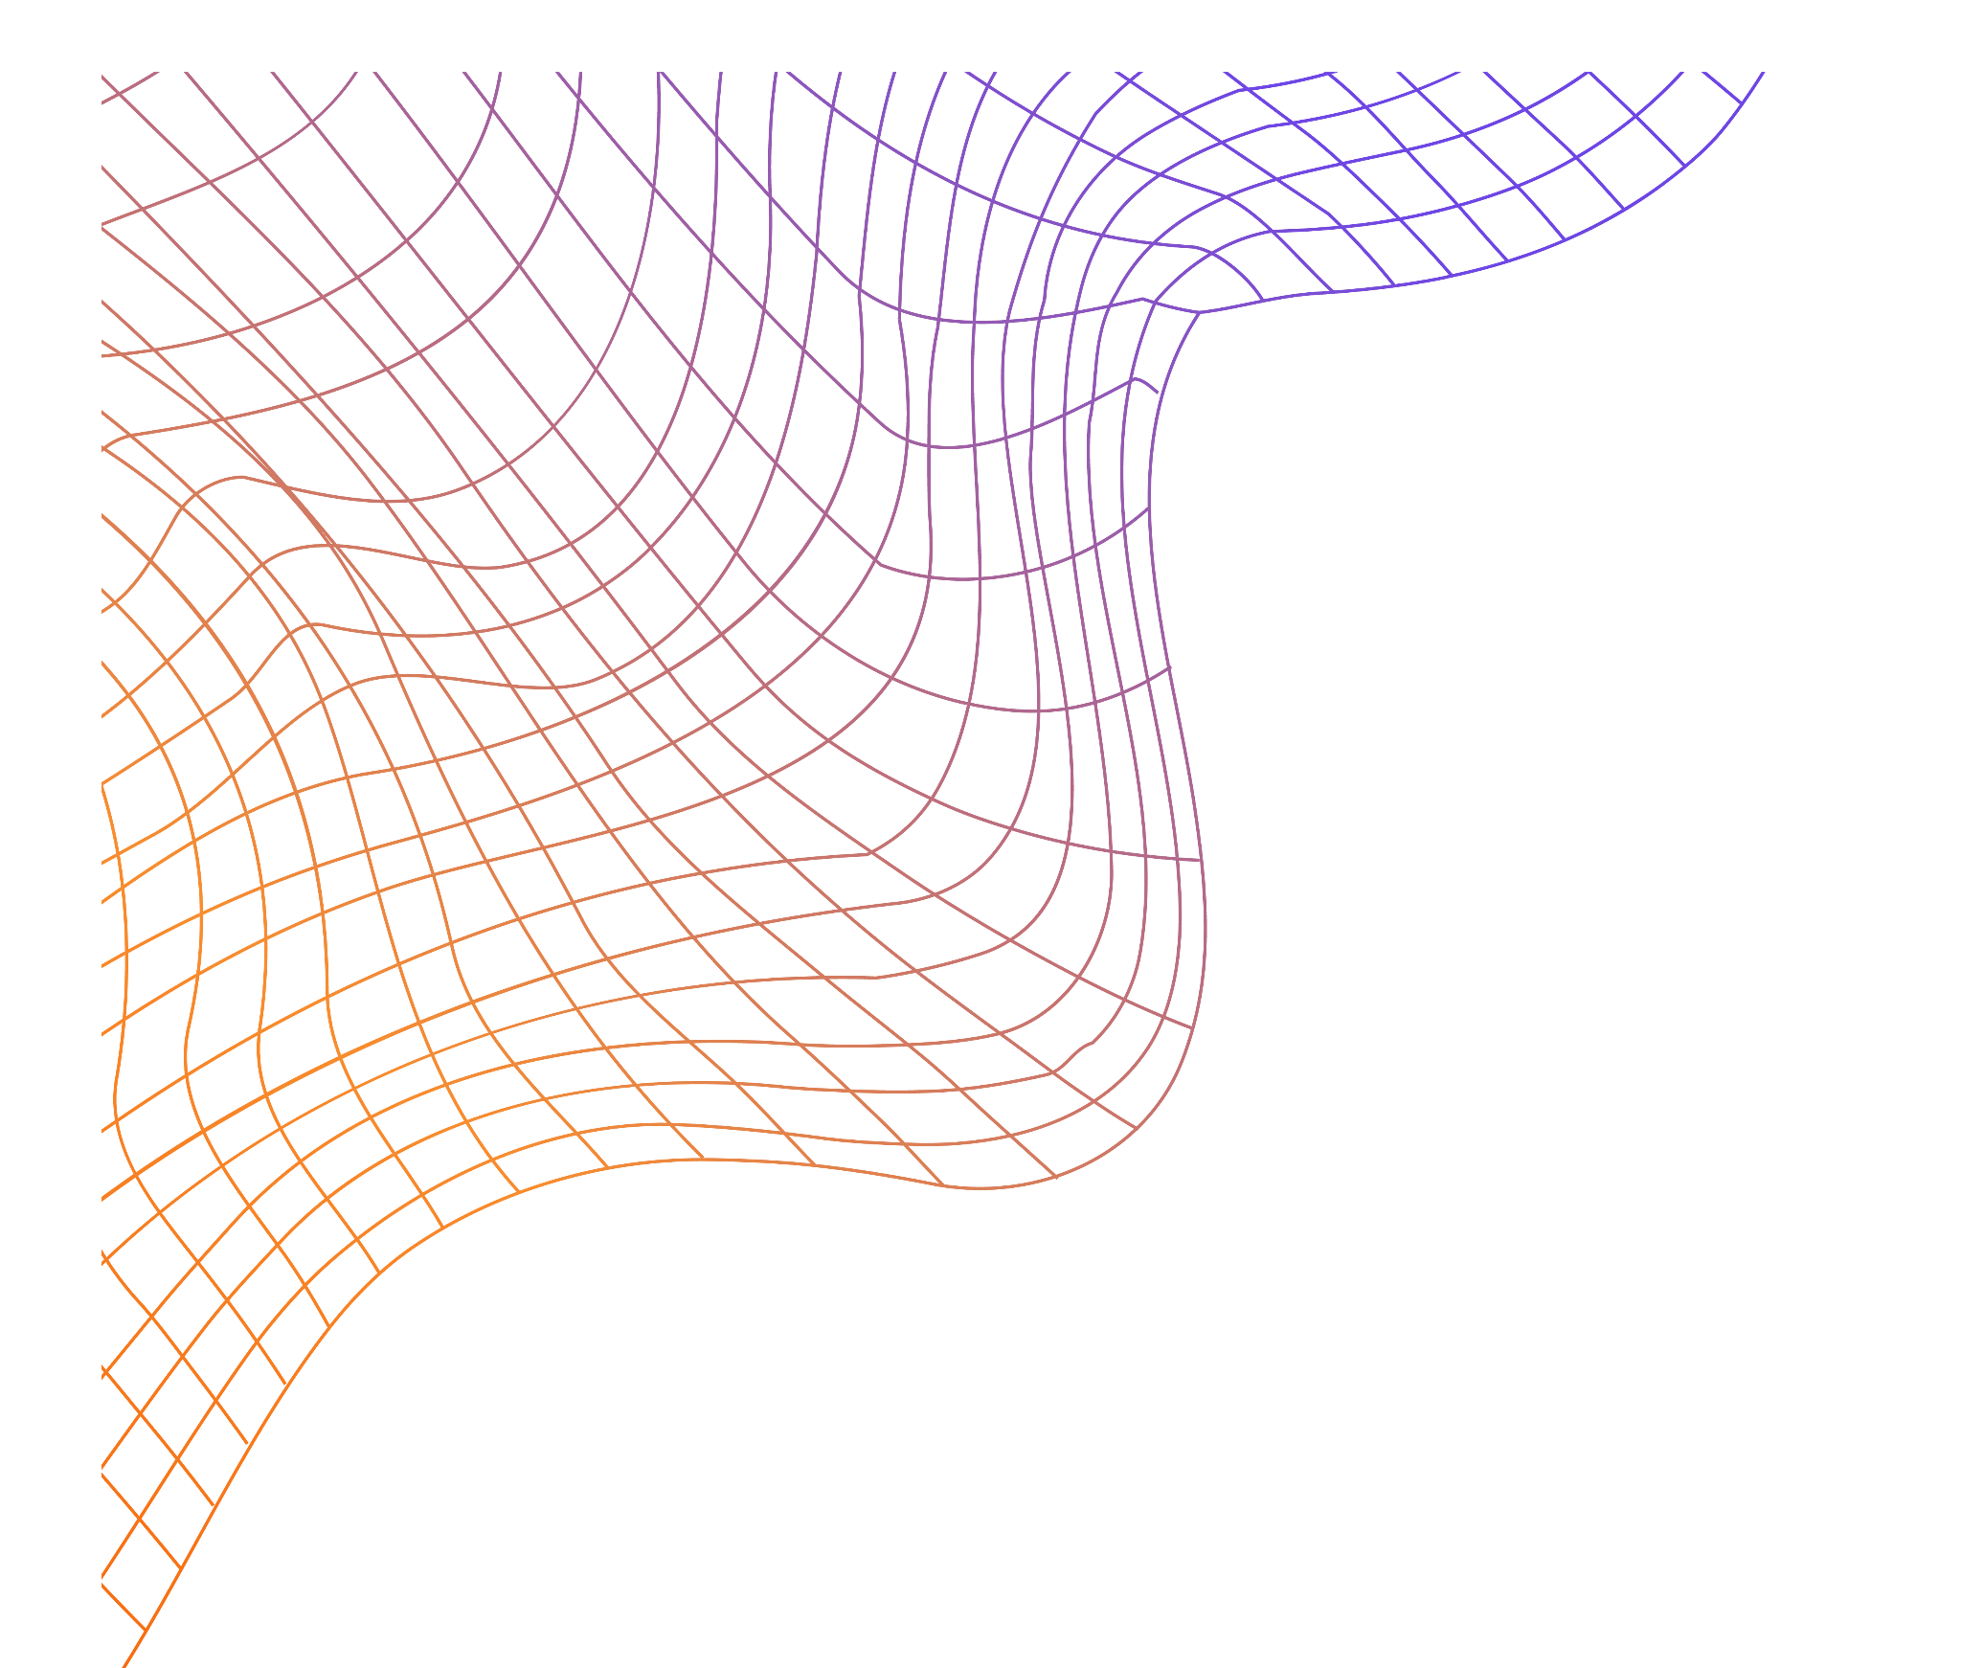
SimuPhys
An Interactive Toolkit for Visualizing Classical and Quantum Physics Simulations

Slide 2
Team Introduction
Kartik Gupta
Suraj Singh
B.Tech (CSE),
Indian Institute of Information Technology Vadodara
Abhinav Chhajed
B.Tech (CSE),
Indian Institute of Information Technology Vadodara
B.Tech (CSE),
Indian Institute of Information Technology Vadodara

Slide 3
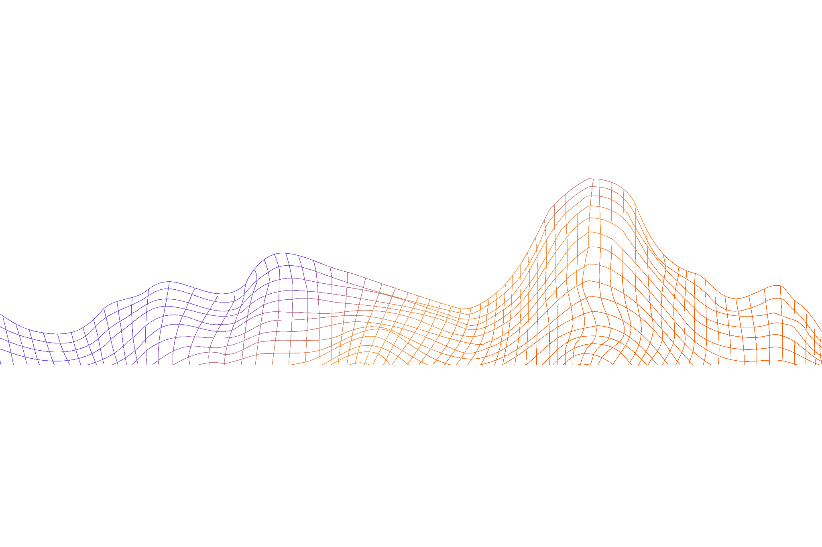
Undergraduate (UG) - Foundations of Computational Physics
Simulations & Visualization in Physics
(Graphical representations using Python, MATLAB, etc.)

Slide 4
Softgoal Requirements
Interactive
Simulations
Conceptual
Learning Aids
Customizable
Scenarios
Simplified
Interaction

Slide 5
Simulation Topics
Electromagnetism
Quantum
Mechanics
Classical Mechanics
Electromagnetic Waves
Laplace’s Potential Fields
RLC circuit simulations
Schrödinger wave equation
Quantum Fourier Transform
Vector Fields
Oscillation Variations
Projectile Motion

Slide 6
System Architecture

Slide 7
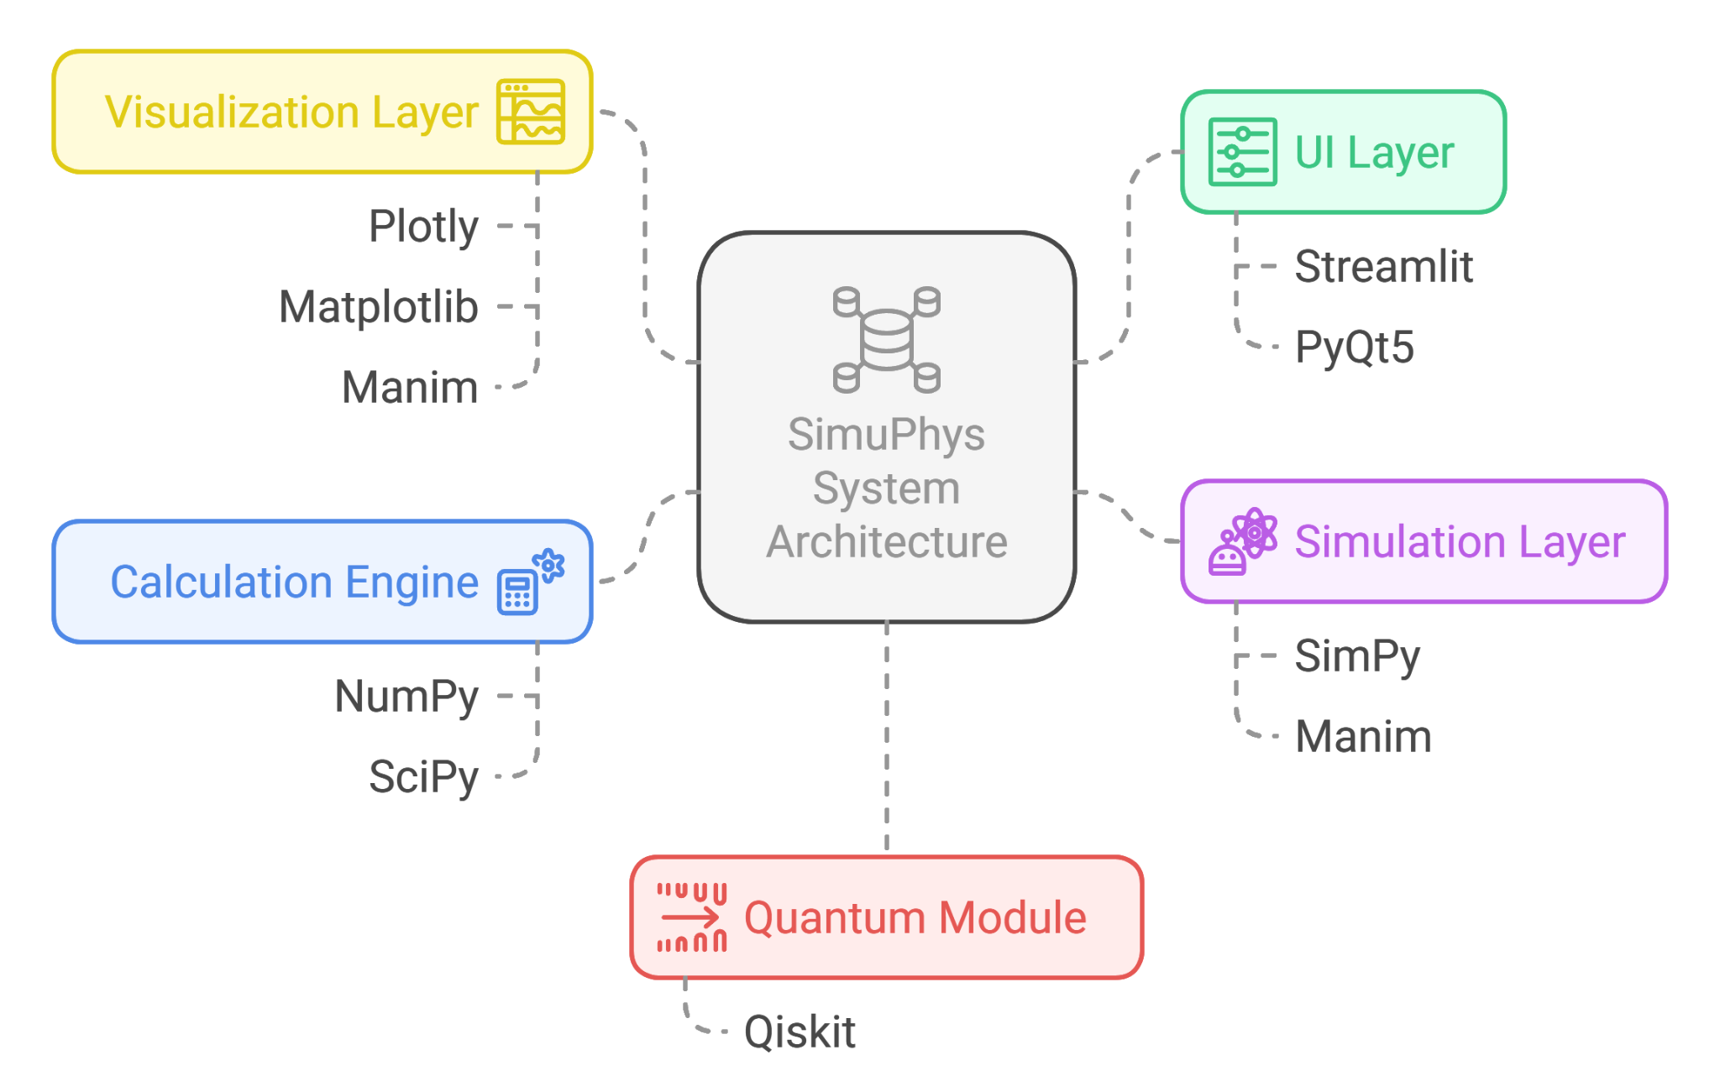

Slide 8
Some Trial Visualizations and Simulations

Slide 9
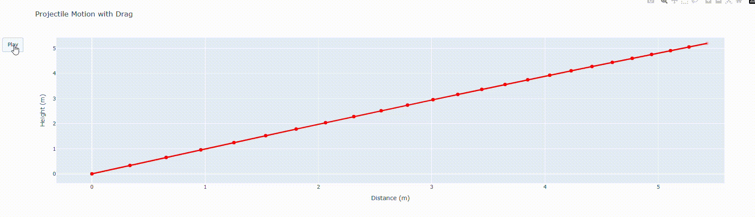
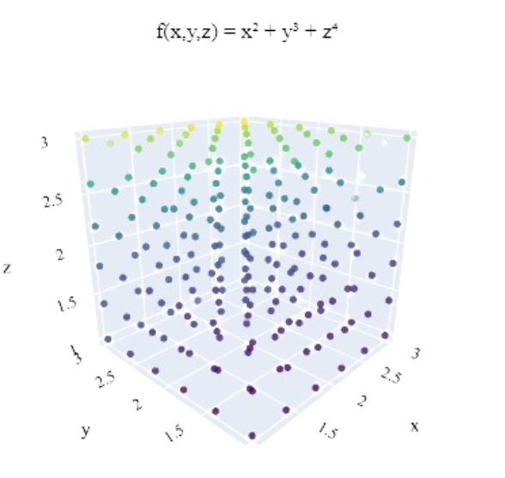
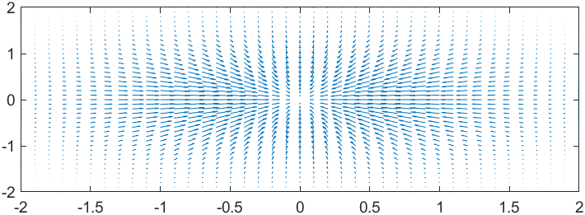

Slide 10
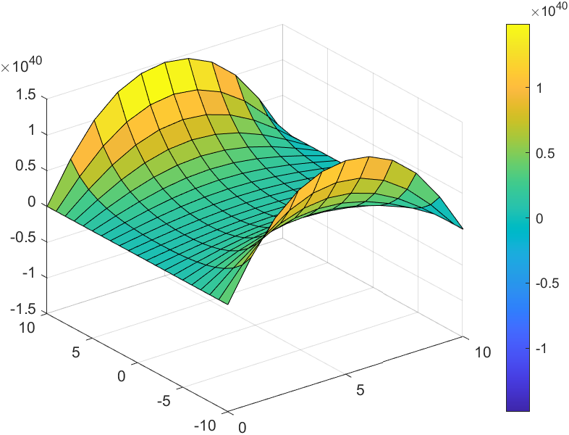
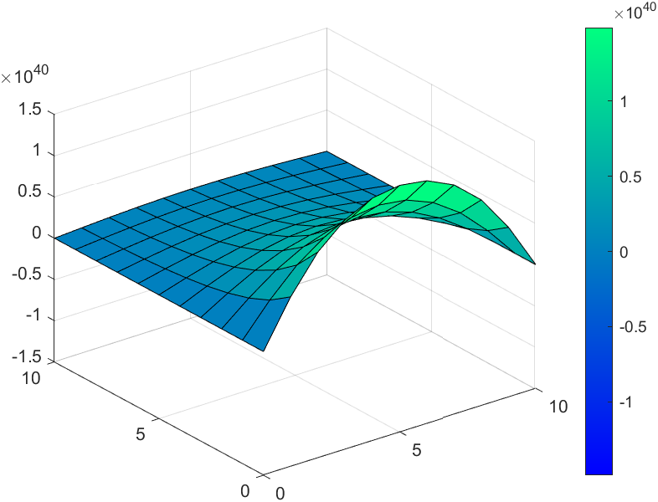
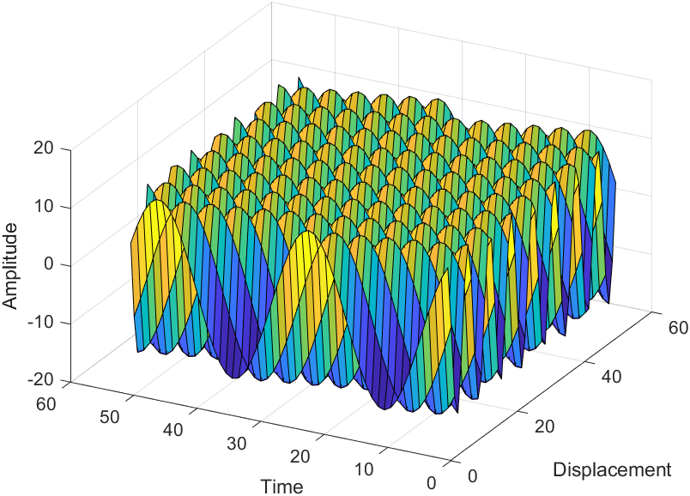
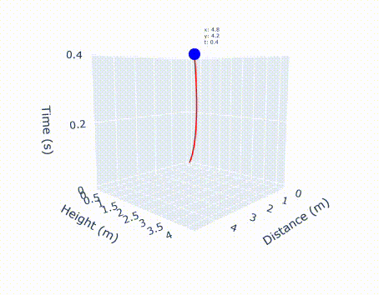

Slide 11
Educational Impacts
Aligned with NEP
2020 Vision
Enhancing Conceptual
Understanding
Classroom & Lab Integration
SimuPhys promotes Experiential Learning.
It also integrates computational thinking, coding, and physics.
Visualizing complex phenomena.
Promotes scientific curiosity and critical thinking.
Can be used as a virtual lab toolkit in UG and PG classrooms.

Slide 12

Thanks!
Do you have any questions?
Contact Info

